Slide 1
Named Entity Extraction from Annotated PDFs Using Generative AI
Leveraging Advanced NLP Techniques for Enhanced Data Extraction

Slide 2
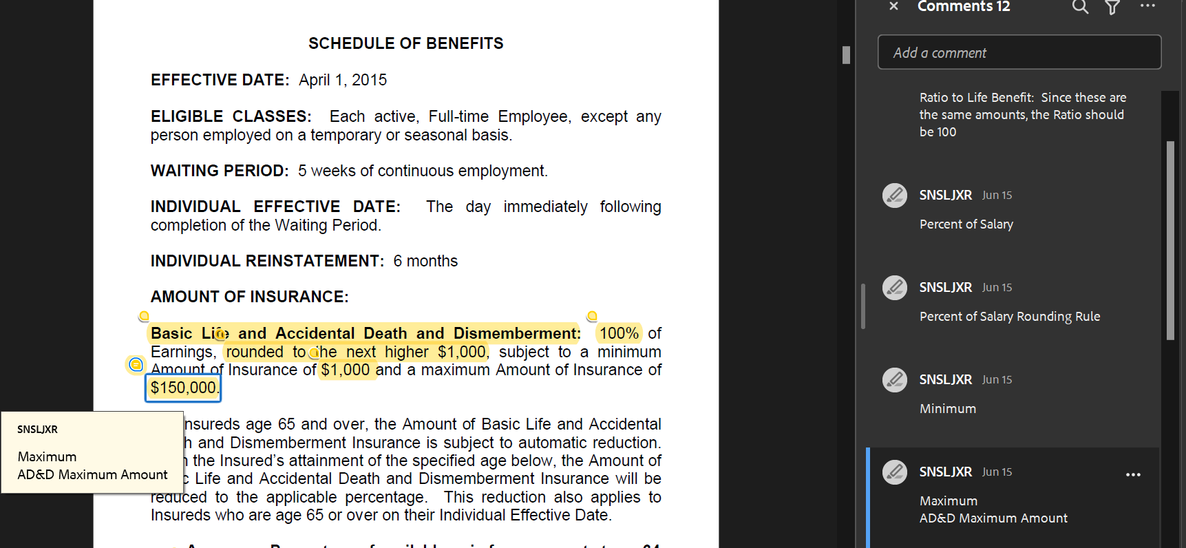
Introduction
This presentation explores a Generative AI solution for Named Entity Recognition (NER) using non-annotated documents, leveraging insights from pre-annotated documents.
Our primary focus is on extracting critical entities relevant to the insurance domain.
We will examine the Basic Life coverage line, which contains approximately 30 entities, initially targeting the extraction of 6 key entities.
The workflow involves uploading a document from which key entities are extracted and presented in a structured table format.

Slide 3
Objectives & Methodology
Objectives :
Achieve accurate entity extraction from non annotated documents.
Identify and extract 30 distinct entities, commencing with 6 key entities that are most prevalent.
Methodology:
Entity Definitions: Providing comprehensive definitions to the model for improved comprehension and context.
Initial Strategy: Initiated with a zero-shot learning approach, leading to inconsistent outputs.
Adaptation: Transitioned to a few-shot learning approach to enhance output consistency and reliability.

Slide 4





Solution Approach
Non-Annotated Document
Upload Non-Annotated Document
Analyze Document Using Insights from Pre-Annotated Data
Extract Critical Entities for Insurance Domain
Present Extracted Entities in Structured Table Format

Slide 5
Prompt Engineering
Crafted Prompt:
"You are a highly intelligent and accurate Named-Entity Recognition (NER) system for the insurance domain. I will provide you the definitions of the entities you need to extract, along with sentences from which you will extract the entities. The output must be in JSON format, as specified in the examples. Your task is to recognize and extract specific types of predefined named entities from the provided passage.“
Context:
Maximum: Maximum dollar amount an employee can receive for Life Benefits.
AD&D Maximum Amount: Maximum dollar amount an employee can receive for AD&D Benefits.
Acceleration Max %: Benefit allows employees who are diagnosed as being terminally ill to receive a percentage of portion of their life benefit before they become deceased.
Acceleration Max Amount: Benefit allows employees who are diagnosed as being terminally ill to receive a portion of their life benefit before they become deceased.
Elimination Period: Elimination period for the Waiver of Premium benefit. The number of months an employee must be disabled prior to the Waiver of Premium benefit beginning.
Coverage Termination Age: Termination age for the Waiver of Premium benefit. The age when an employee’s Waiver of Premium benefit will end​.“

Slide 6
Prompt Engineering
Few-shot examples
{
"role": "user",
"content": "\nLIFE INSURANCE\nBenefit Amount\nPersonal Life Insurance\nTwo times Basic Annual Earnings, rounded to the next higher\n$1,000; subject to a maximum of $500,000. AD&D INSURANCE\nBenefit Amount\nAD&D Insurance Principal Sum\nTwo times Basic Annual Earnings, rounded to the next higher\n$1,000; subject to a maximum of $500,000\n ACCELERATED DEATH BENEFIT.\nYou may elect to withdraw an Accelerated\nDeath Benefit in any $1,000 increment. The amount is subject to:\n(1)\na minimum of $50,000 or 25% of your amount of Personal Life Insurance (whichever is less);\nand\n(2)\na maximum of $250,000 or 75%"
},
{
"role": "assistant",
"content": '{"Maximum": "$500,000", "AD&D Maximum Amount": "$500,000", "Acceleration Max %": "75%","Acceleration Max Amount":"$250,000","Elimination Period":"None", "Coverage Termination Age" : "None"}'
},
{
"role": "user",
"content": "WAIVER OF PREMIUM IN EVENT OF TOTAL DISABILITY\nWe will extend the Amount of Insurance during a period of Total \nDisability for one (1) year if:\n(1) you become totally disabled prior to age 60;\n(2) the Total Disability begins while you are insured;\n(3) the Total Disability begins while the Policy is in force;\n(4) the Total Disability lasts for at least 9 months LIFE INSURANCE LIVING BENEFIT RIDER .......... 15.0\nLRS-6441-1 Ed. 9/89\nPage 1.0\nSCHEDULE OF BENEFITS\nEFFECTIVE DATE: April 1, 2015\nELIGIBLE CLASSES: Each active, Full-time Employee, except any \nperson employed on a temporary or seasonal basis.\nWAITING PERIOD: 5 weeks of continuous employment.\nINDIVIDUAL EFFECTIVE DATE: The day immediately following \ncompletion of the Waiting Period.\nINDIVIDUAL REINSTATEMENT: 6 months\nAMOUNT OF INSURANCE:\nBasic Life and Accidental Death and Dismemberment: 100% of \nEarnings, rounded to the next higher $1,000, subject to a minimum \nAmount of Insurance of $1,000 and a maximum Amount of Insurance of \n$150,000 Living Benefit will be an \namount equal to 75% of the Death Benefit applicable to the Insured under \nthe Policy on the date of the Certification of Terminal Illness, subject to a \nmaximum benefit of $500,000"
},
{
"role": "assistant",
"content": '{"Maximum": "$150,000", "AD&D Maximum Amount": "$150,000", "Acceleration Max %": "75%","Acceleration Max Amount":"$500,000","Elimination Period":"9 months", "Coverage Termination Age" : "60"}'
}

Slide 7
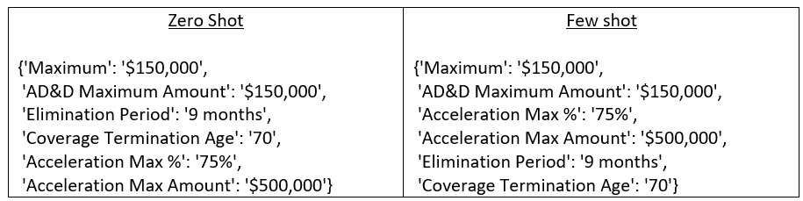
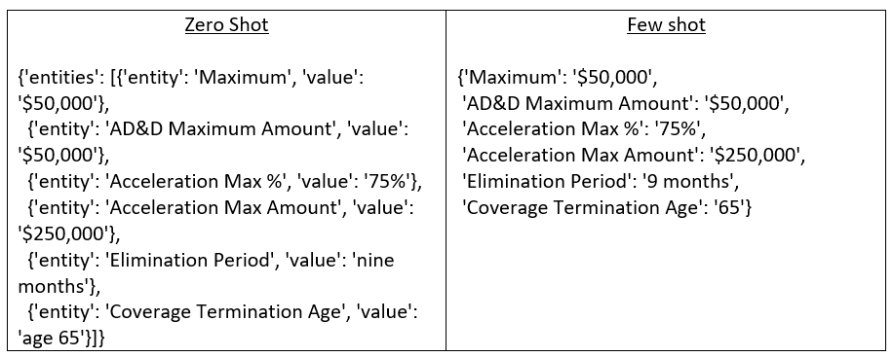
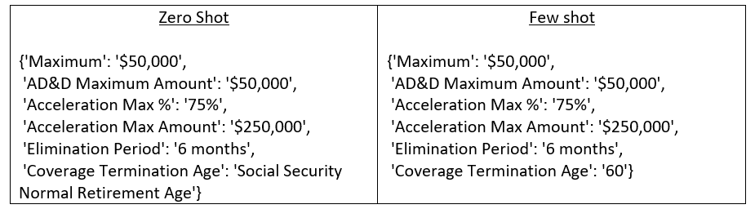
Performance
Comparison of output consistency pre- and post-adaptation to the few-shot approach.
Model: GPT-4o Version: 2024-08-01-preview

Slide 8
Performance
Entity | Value | Actual
Maximum | $300,000 | $300,000
AD&D Maximum Amount | None | None
Acceleration Max % | 75% | 75%
Acceleration Max Amount | $225,000 | $225,000
Elimination Period | 9 months | 9 months
Coverage Termination Age | 65 | 65
Entity | Value | Actual
Maximum | $25,000 | $25,000
AD&D Maximum Amount | $25,000 | $25,000
Acceleration Max % | 75% | 75%
Acceleration Max Amount | $18,750 | $18,750
Elimination Period | 6 months | 6 months
Coverage Termination Age | None | 60
*Cigna - Basic Life Benefit Booklet 6.14.21.pdf
*Mutual of Omaha - Basic Life Benefit Booklet 6.14.21.pdf

Slide 9
Conclusion
The transition from zero-shot to few-shot learning has significantly improved entity extraction accuracy.
The use of precise definitions and structured prompts is crucial for effective NER in specialized domains like insurance.
Expand entity identification to the full set of 30 entities.
Further refine the model through iterative training and validation processes.
Explore additional AI methodologies to enhance extraction capabilities.

